Slide 1
AI Powered Hyper-Personalization Recommendation System
Project By:
Anirban Sikder
Devtanu Misra
Krishnendu Bera
Narasimha M. Edala
Dwaipayan Guha

Slide 2
Contents
Agenda
System Overview
Key Features Summary
Data Collection Overview
Customer Schema Diagram
Segment Schema Diagram
Product Schema Diagram
Transaction Schema Diagram
API Endpoints Overview
Analyze Recommendable Transactions API
Transaction Analysis API Flow Diagram
Analyze Customer Product API
Customer Product Analysis API Sequence Diagram
Flask API Setup for Recommendation Service
Production Readiness Overview
Application Onboarding & Data Ingestion Flow
Daily Scheduler: Transaction Validation
Bi-Weekly Scheduler: Customer Transaction Analysis
Bi-Weekly Scheduler: Recommendation Notification
Benefits for Wells Fargo LOB Teams
Production Readiness - Real-Time Communication & Integration
Conclusion & Q&A

Slide 3
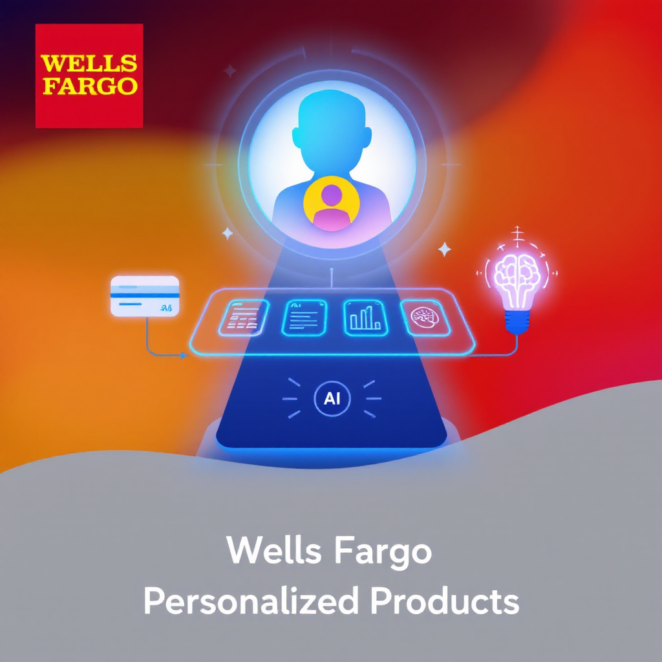
Empowering Wells Fargo with Personalized Product Recommendations
Overview
Introducing our personalized recommendation system designed for Wells Fargo.
Objective
Enhance customer experience by suggesting tailored products based on data insights.
Approach
Leverage transaction data, customer profiles, and LLM for intelligent product recommendations.

Slide 4

Agenda
01
02
03
Introduction
Architecture Overview
Production Readiness
Brief on the recommendation system and its value proposition.
System design, API flows, and key data components.
How the system integrates with Wells Fargo teams for real-time recommendations.

Slide 5
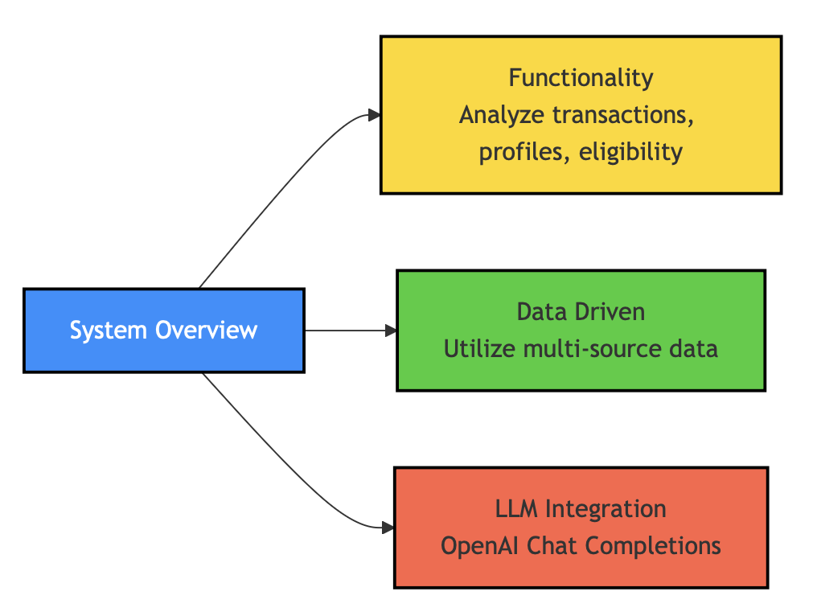
System Overview
Functionality
Analyzes customer transactions, profiles, and product eligibility.
Data Driven
Utilizes data from multiple sources to drive recommendations.
LLM Integration
Employs OpenAI Chat Completions for generating recommendations.

Slide 6
Key Features Summary
01
02
03
Customer Transactions
Profile Analysis
Eligibility & Recommendations
Tracks and analyzes recent transactions.
Considers income, credit score, and interests.
Evaluates product criteria to generate personalized suggestions.

Slide 7
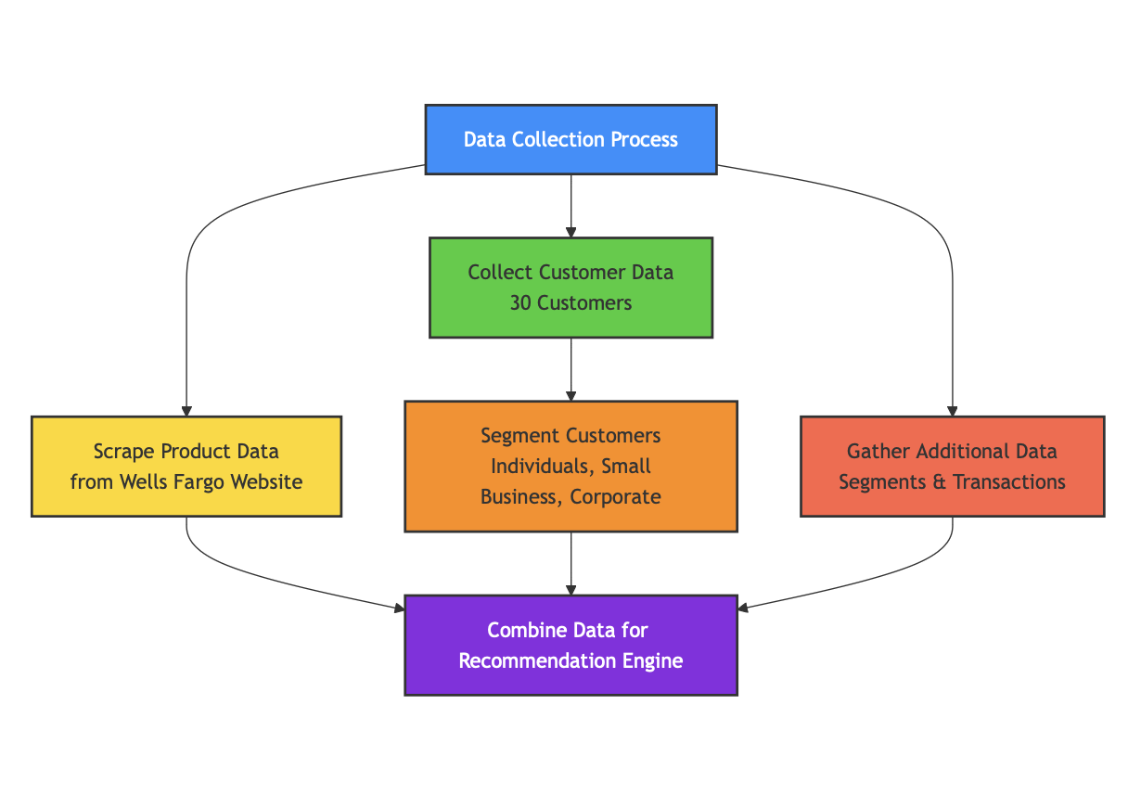
Data Collection Overview
Product Data
Scraped from the Wells Fargo website for available products.
Customer Data
Dataset of 30 customers segmented into Individuals, Small Business, and Corporate.
Additional Data
Includes segments and transaction collections to support recommendations.

Slide 8
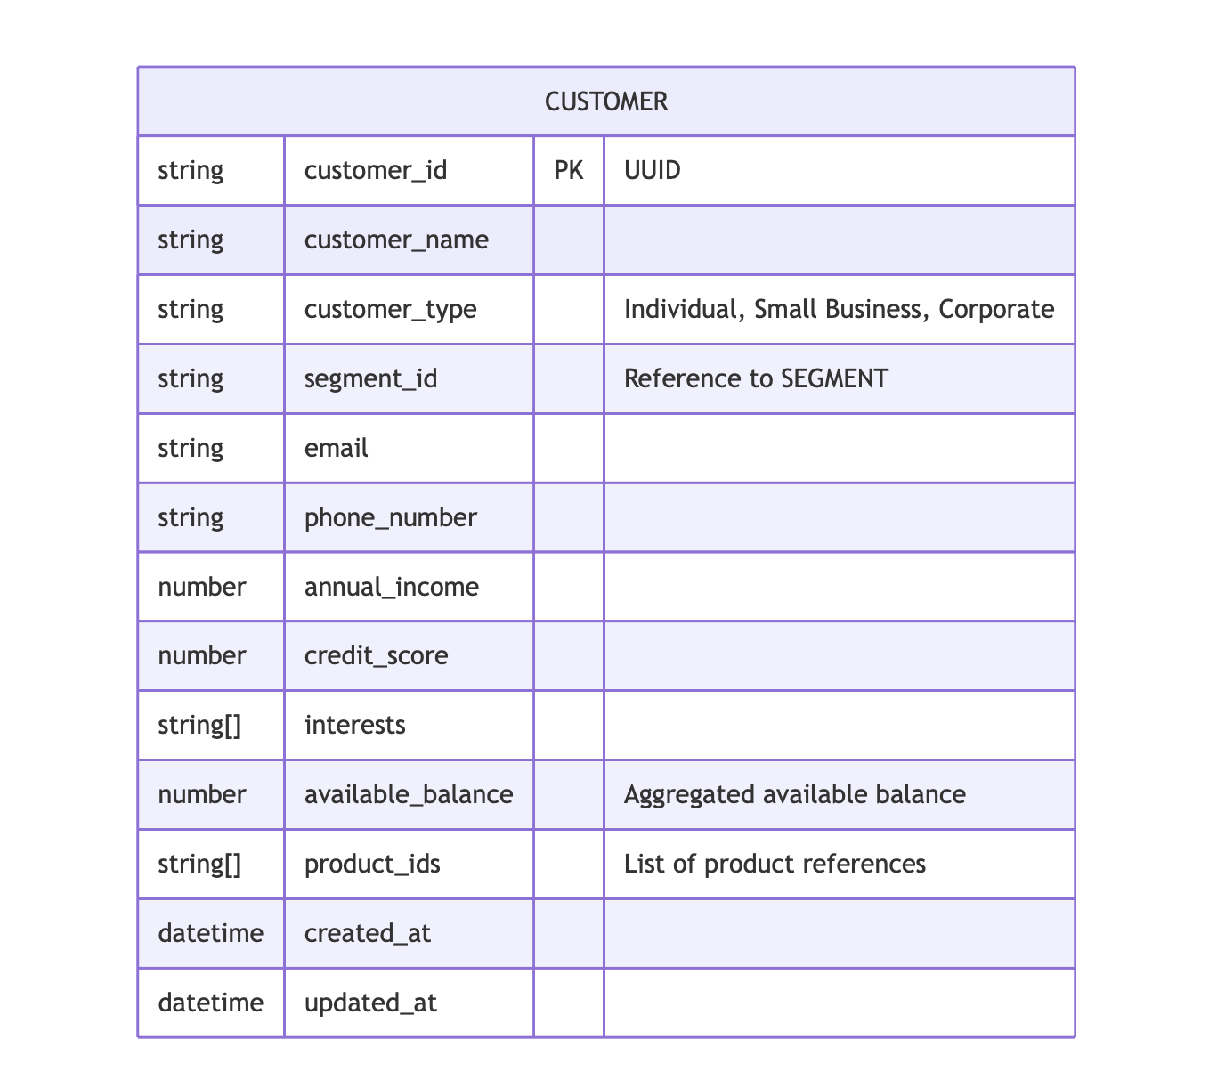
Customer Schema Diagram
Attributes
Displays key customer fields like ID, name, and product references.
Relationships
Illustrates how customers are linked to segments and transactions.
Visualization
Diagram shows data structure for customer records.

Slide 9
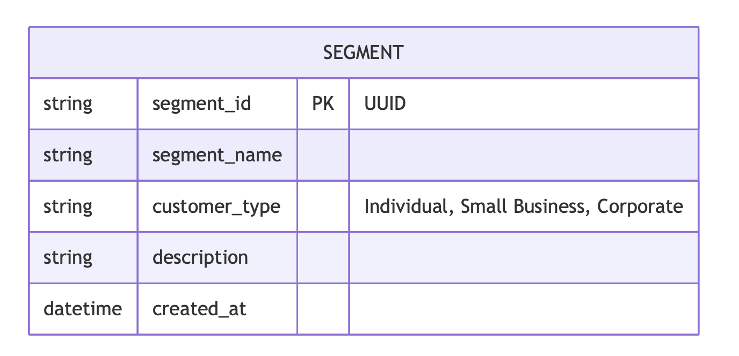
Segment Schema Diagram
Segment Details
Defines segments such as Individual, Small Business, and Corporate.
Mapping
Shows how segments correlate with customer types.
Visualization
Diagram depicts the segment structure and relationships.

Slide 10
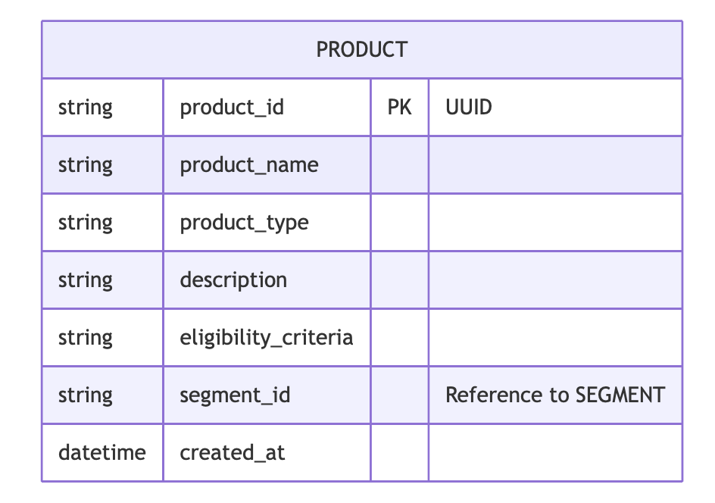
Product Schema Diagram
Product Details
Lists product attributes and eligibility criteria.
Segment Mapping
Links products to specific customer segments.
Eligibility Criteria
Defines an eligibility criteria for customers to use this product

Slide 11
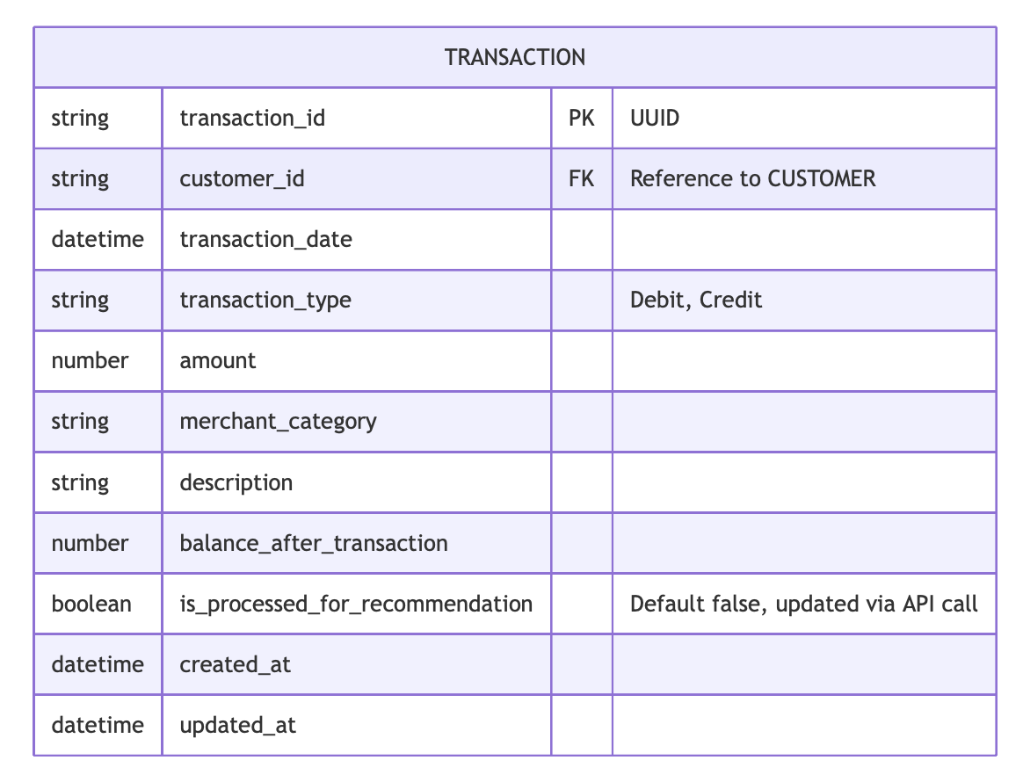
Transaction Schema Diagram
Transaction Fields
Includes attributes like transaction ID, date, and amount.
Validation Flags
Highlights the flag for recommendation processing.
Description
Has a description for the transaction if successful and failure reason if failed.

Slide 12
API Endpoints Overview
01
02
03
Endpoints
Methods
Purpose
Overview of key API endpoints in the recommendation system.
Describes the HTTP methods and routes used.
Explains the role of each endpoint in the system.

Slide 13
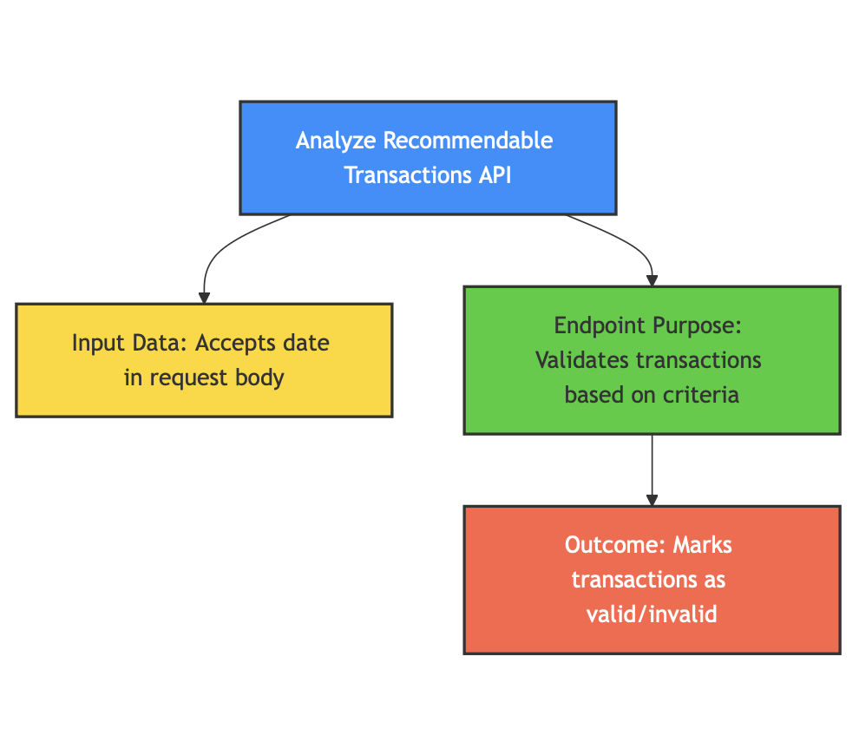
Analyze Recommendable Transactions API
Endpoint Purpose
Validates transactions based on specified criteria.
Input Data
Accepts a date in the request body to process daily transactions.
Outcome
Marks transactions as valid/invalid for recommendations.

Slide 14
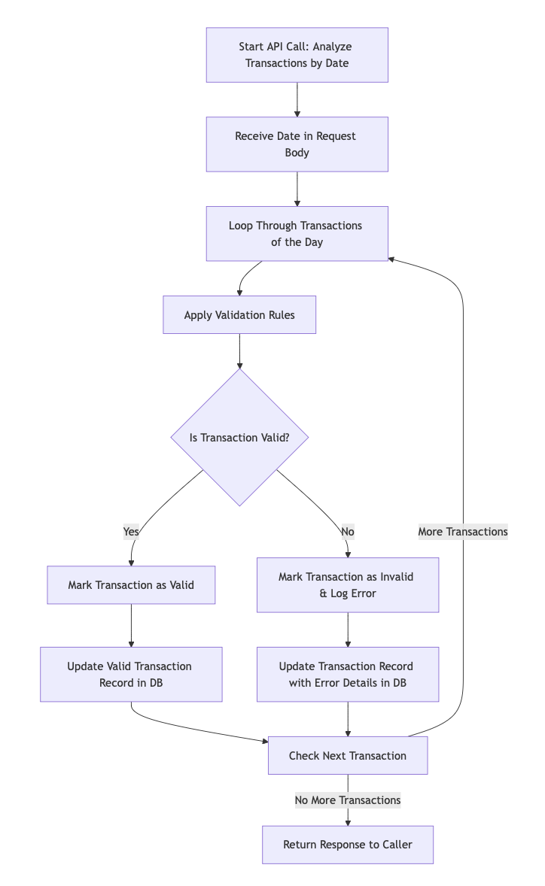
Transaction Analysis API Flow Diagram
Flow Start
Initiates when the API receives a request with a date.
Validation Steps
Iterates through transactions, applying validation rules.
Response Flow
Updates DB records and returns list of valid transactions.

Slide 15
Analyze Customer Product API
01
02
03
API Purpose
Data Retrieval
Processing
Generates product recommendations based on customer data.
Fetches customer profile and two-week transaction history.
Computes the difference between used and available products.

Slide 16
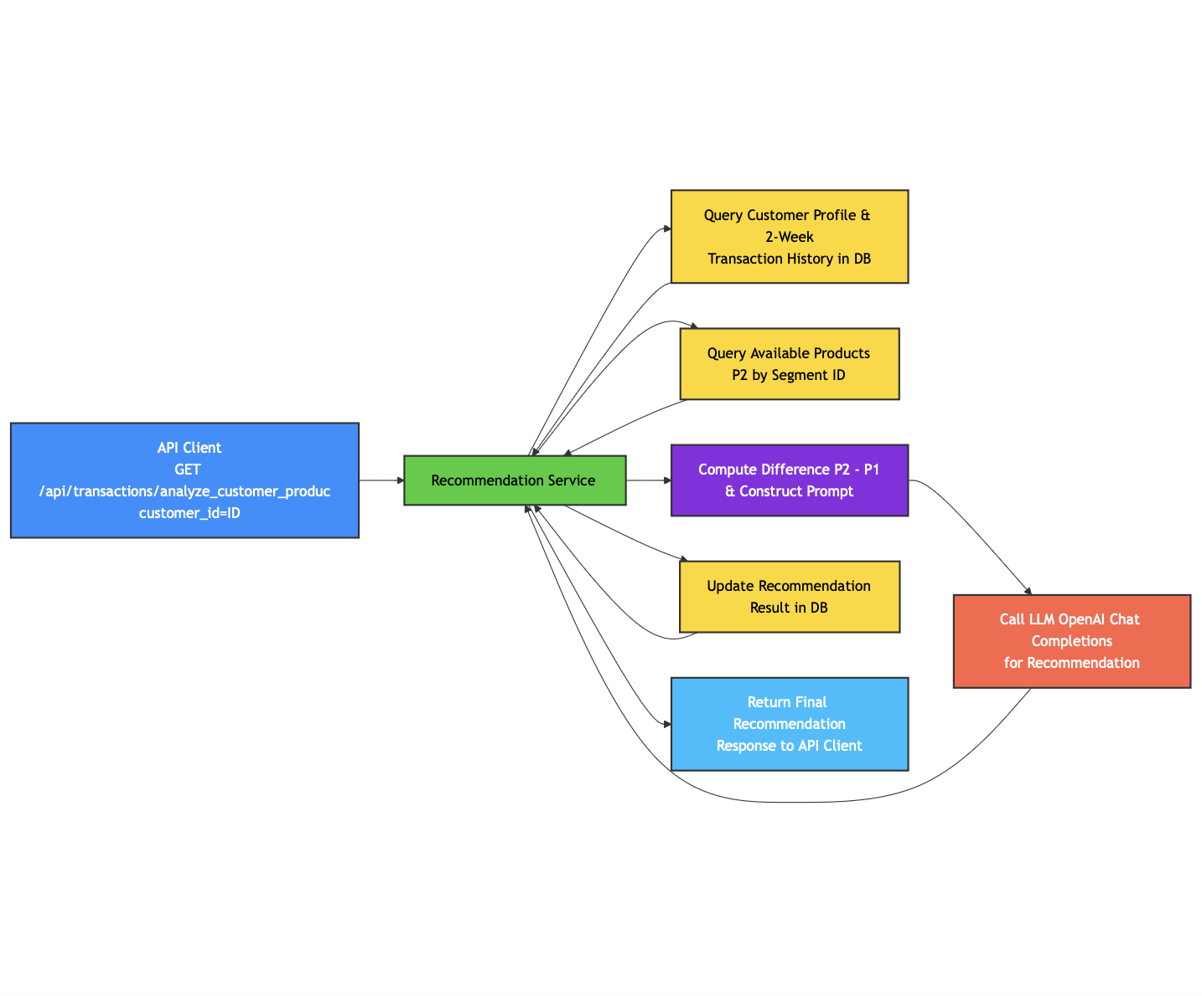
Customer Product Analysis API Sequence
Sequence Start
Initiated by the API call with customer_id.
Data Retrieval
Fetches customer details, transactions, and product data.
LLM Integration
Calls the LLM to generate a recommendation.

Slide 17
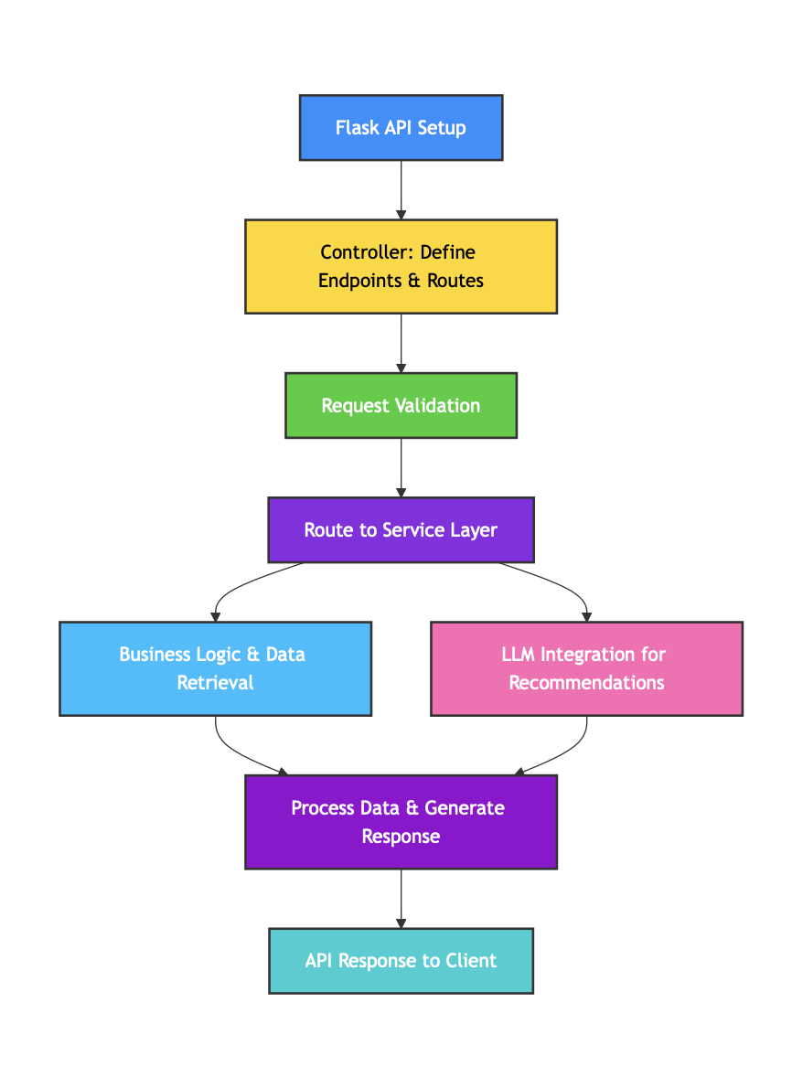
Flask API Setup for Recommendation Service
Controller Setup
Defines API endpoints and routes in Flask.
Service Layer
Handles business logic, including data retrieval and LLM calls.
Endpoint Configuration
Ensures secure and efficient communication between components.

Slide 18
Production Readiness Overview
01
02
03
Architecture
Integration
Operational Readiness
The recommendation system is designed as a robust, standalone service that leverages API-driven processing. It isolates complex operations into dedicated endpoints and kafka topics/consumers.
The system can seamlessly integrate with various Wells Fargo Lines of Business (LOBs) through easy onboarding of external applications and the use of Kafka messaging for data ingestion and notifications.
With support for asynchronous processing and batch operations, the system is engineered to handle high data volumes, ensuring efficient performance and quick recovery from potential issues.

Slide 19
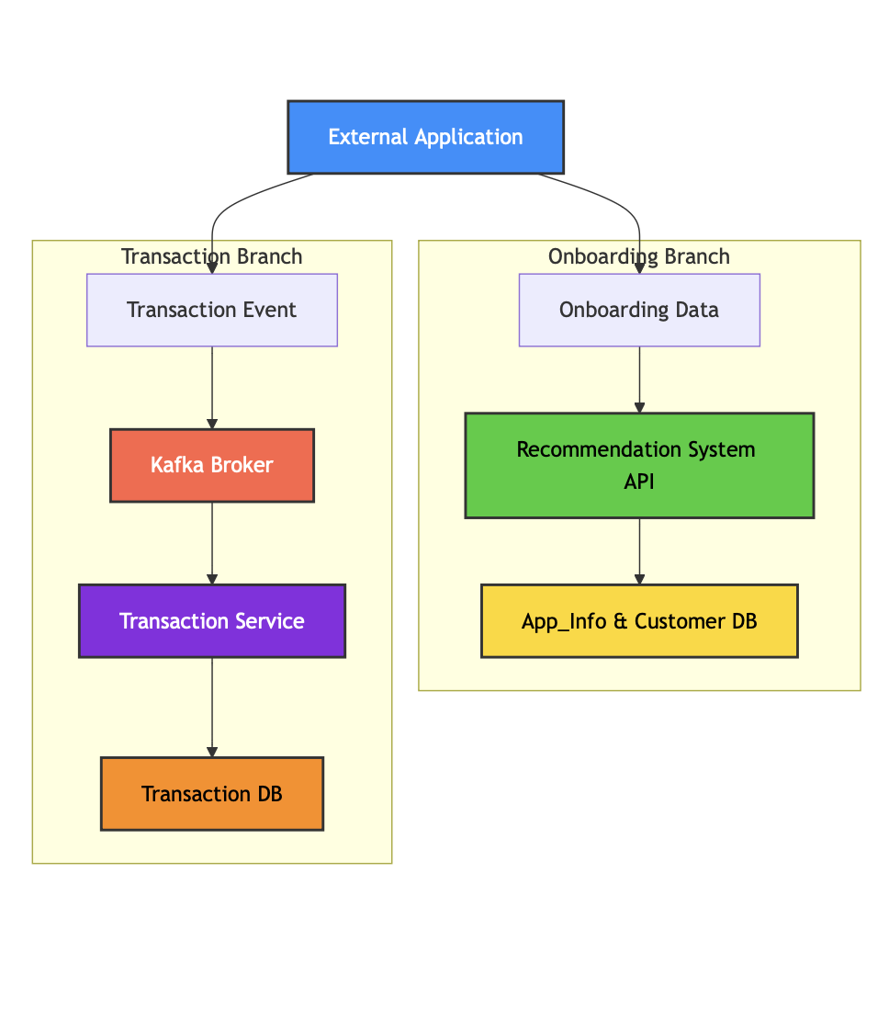
Application Onboarding & Data Ingestion Flow
Onboarding
External applications provide app_info and customer data.
Kafka Integration
Transaction data is pushed to Kafka topics.
Data Storage
Ingested data is stored in the transaction database.

Slide 20
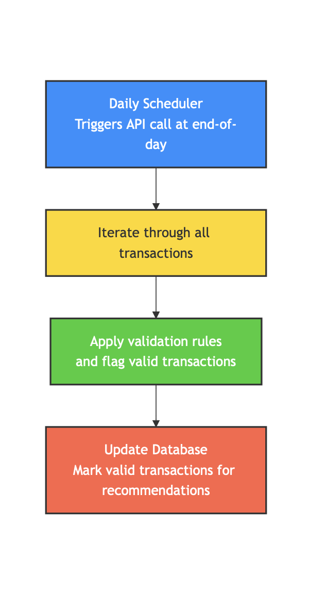
Daily Scheduler: Transaction Validation
Daily Scheduler
Triggers an API call at the end of each day to iterate through all transactions.
Validation Process
Applies validation rules to each transaction and flags valid transactions in the database.
Database Update
Ensures that only transactions marked as valid are processed further for recommendations.

Slide 21
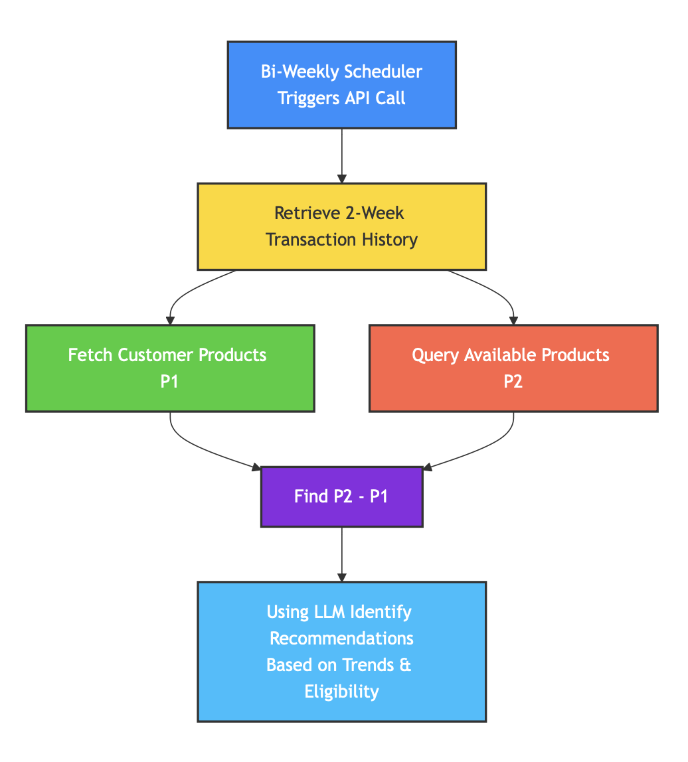
Bi-Weekly Scheduler: Customer Transaction Analysis
Two-Week Data Retrieval
Initiates an API call to fetch each customer's transaction history for the past two weeks.
Profile & Product Comparison
Analyzes customer profiles by comparing products already in use (P1) with available products (P2).
Analysis Outcome
Identifies potential product recommendations based on transaction trends and customer eligibility.

Slide 22
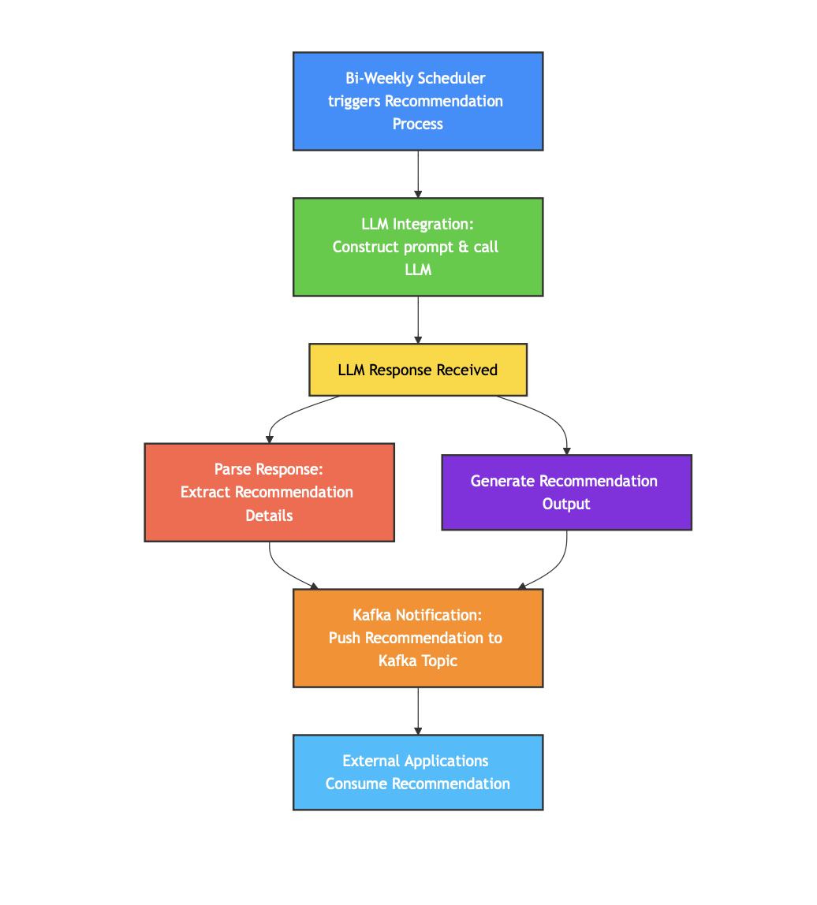
Bi-Weekly Scheduler: Recommendation Notification
LLM Integration
Constructs a prompt using the analysis results and calls the LLM to generate a recommendation.
Recommendation Generation
Parses the LLM response to obtain the recommended product and associated details.
Kafka Notification
Pushes the final recommendation to a Kafka topic specified in the customer's app_info for external consumption.

Slide 23
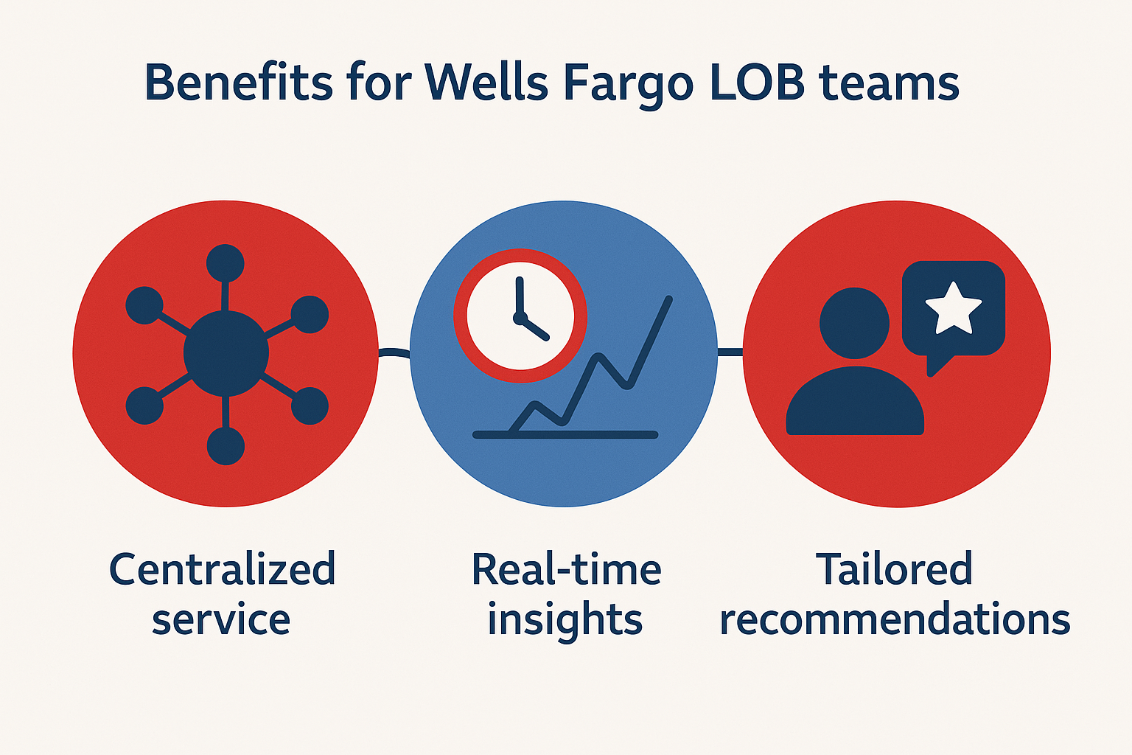
Benefits for Wells Fargo LOB Teams
Centralized Service
Provides a unified recommendation engine across LOBs.
Real-Time Insights
Delivers timely recommendations based on live data.
Tailored Recommendations
Ensures personalized product suggestions for each customer.

Slide 24
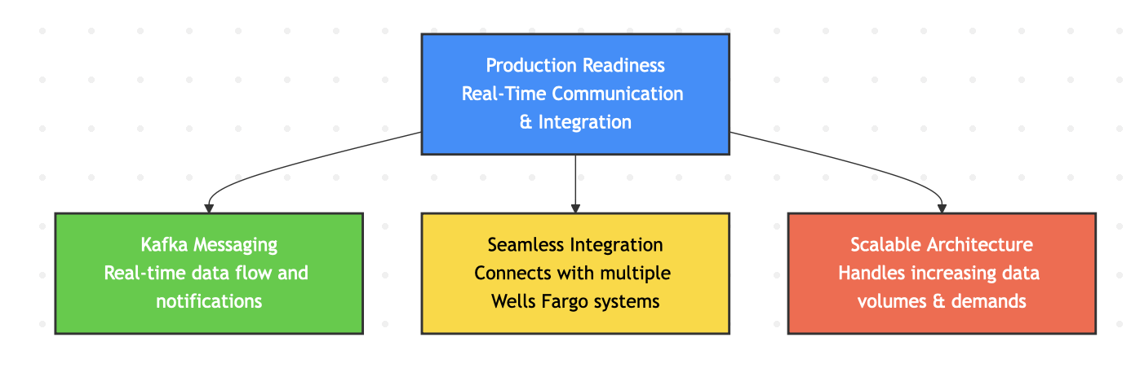
Production Readiness - Real-Time Communication & Integration
Kafka Messaging
Enables real-time data flow and notification delivery.
Seamless Integration
Works with multiple Wells Fargo applications and systems.
Scalable Architecture
Designed to handle increasing data volumes and user demands.

Slide 25
Conclusion & Q&A
01
02
03
Summary
Next Steps
Questions & Discussion
In this presentation, we explored the architecture of our personalized recommendation system for Wells Fargo covering key components including data collection, API-driven processing, and the integration of LLM for generating intelligent recommendations.
Our immediate focus could be on refining API performance, enhancing error handling, and preparing for production deployment. Future improvements will include extended integrations and further scalability enhancements.
Thank you for your attention. We now welcome any questions or feedback to further discuss the solution and its potential impact.

Slide 26
THANK YOU

